Slide 1
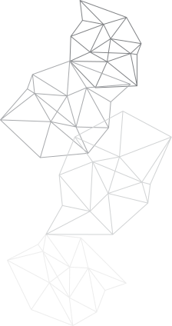



LUNG DISEASE DETECTION
Garv S24CSEU0792
Divyanshu Raj S24CSEU0800

Slide 2
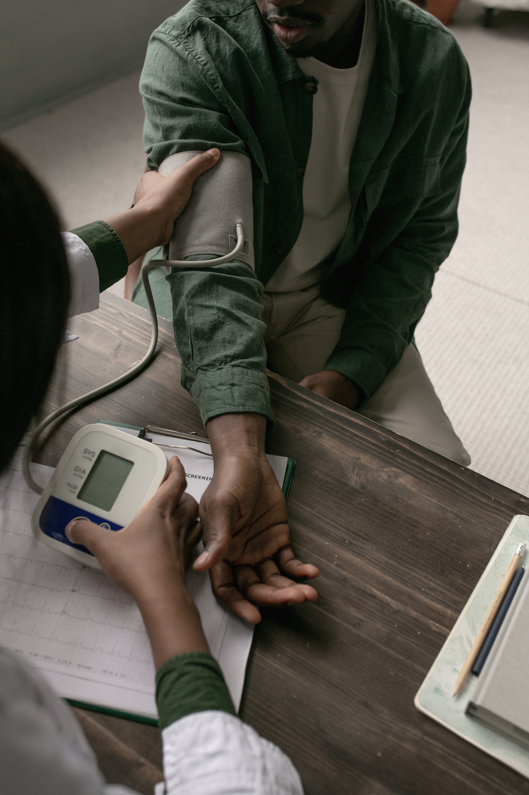
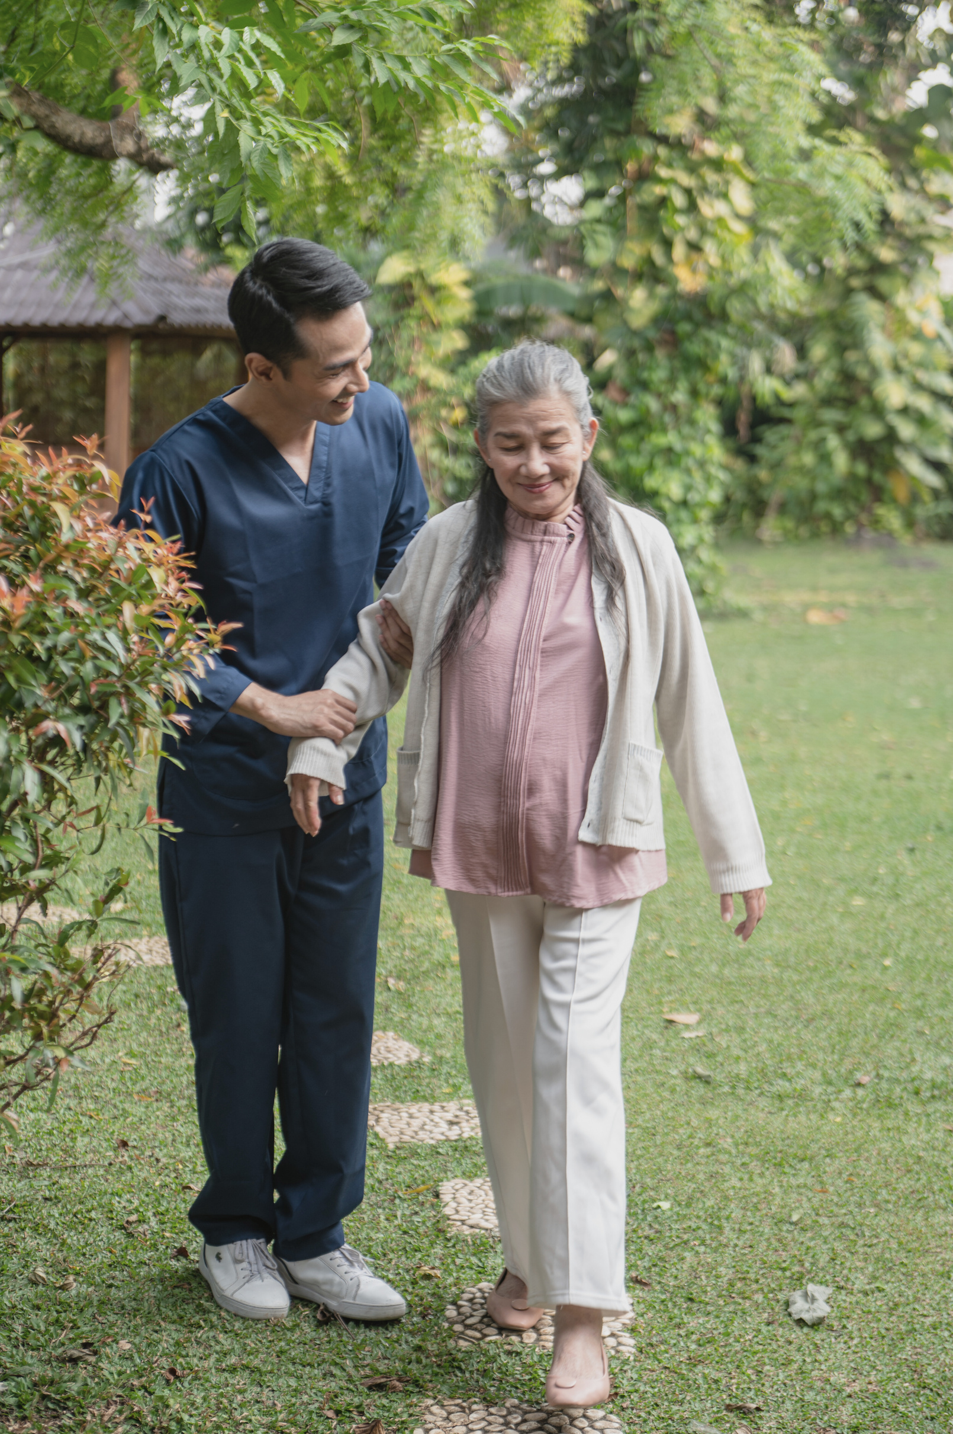
Problem statement
Lung diseases are increasing rapidly worldwide.
Manual diagnosis using chest X-ray/CT images is:
Time-consuming
Requires expert radiologists
Prone to human error
Difficult in rural/low-resource areas

Slide 3
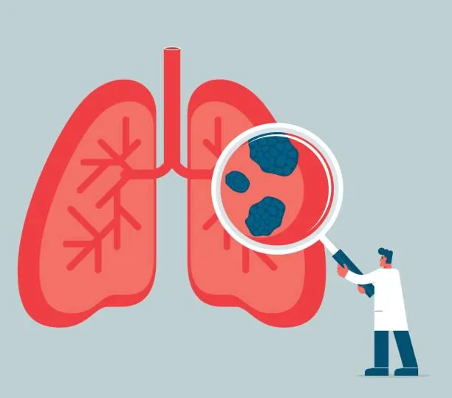

Proposed Solution
The project uses a deep-learning model based on MobileNetV2 to automatically classify lung diseases from chest X-ray images. Images are preprocessed and augmented to improve learning, followed by transfer learning to extract important features. Additional dense and dropout layers are added to enhance performance and reduce overfitting. The model is trained and evaluated using metrics such as accuracy and F1-score, and the final system provides fast and reliable predictions to support medical diagnosis.

Slide 4
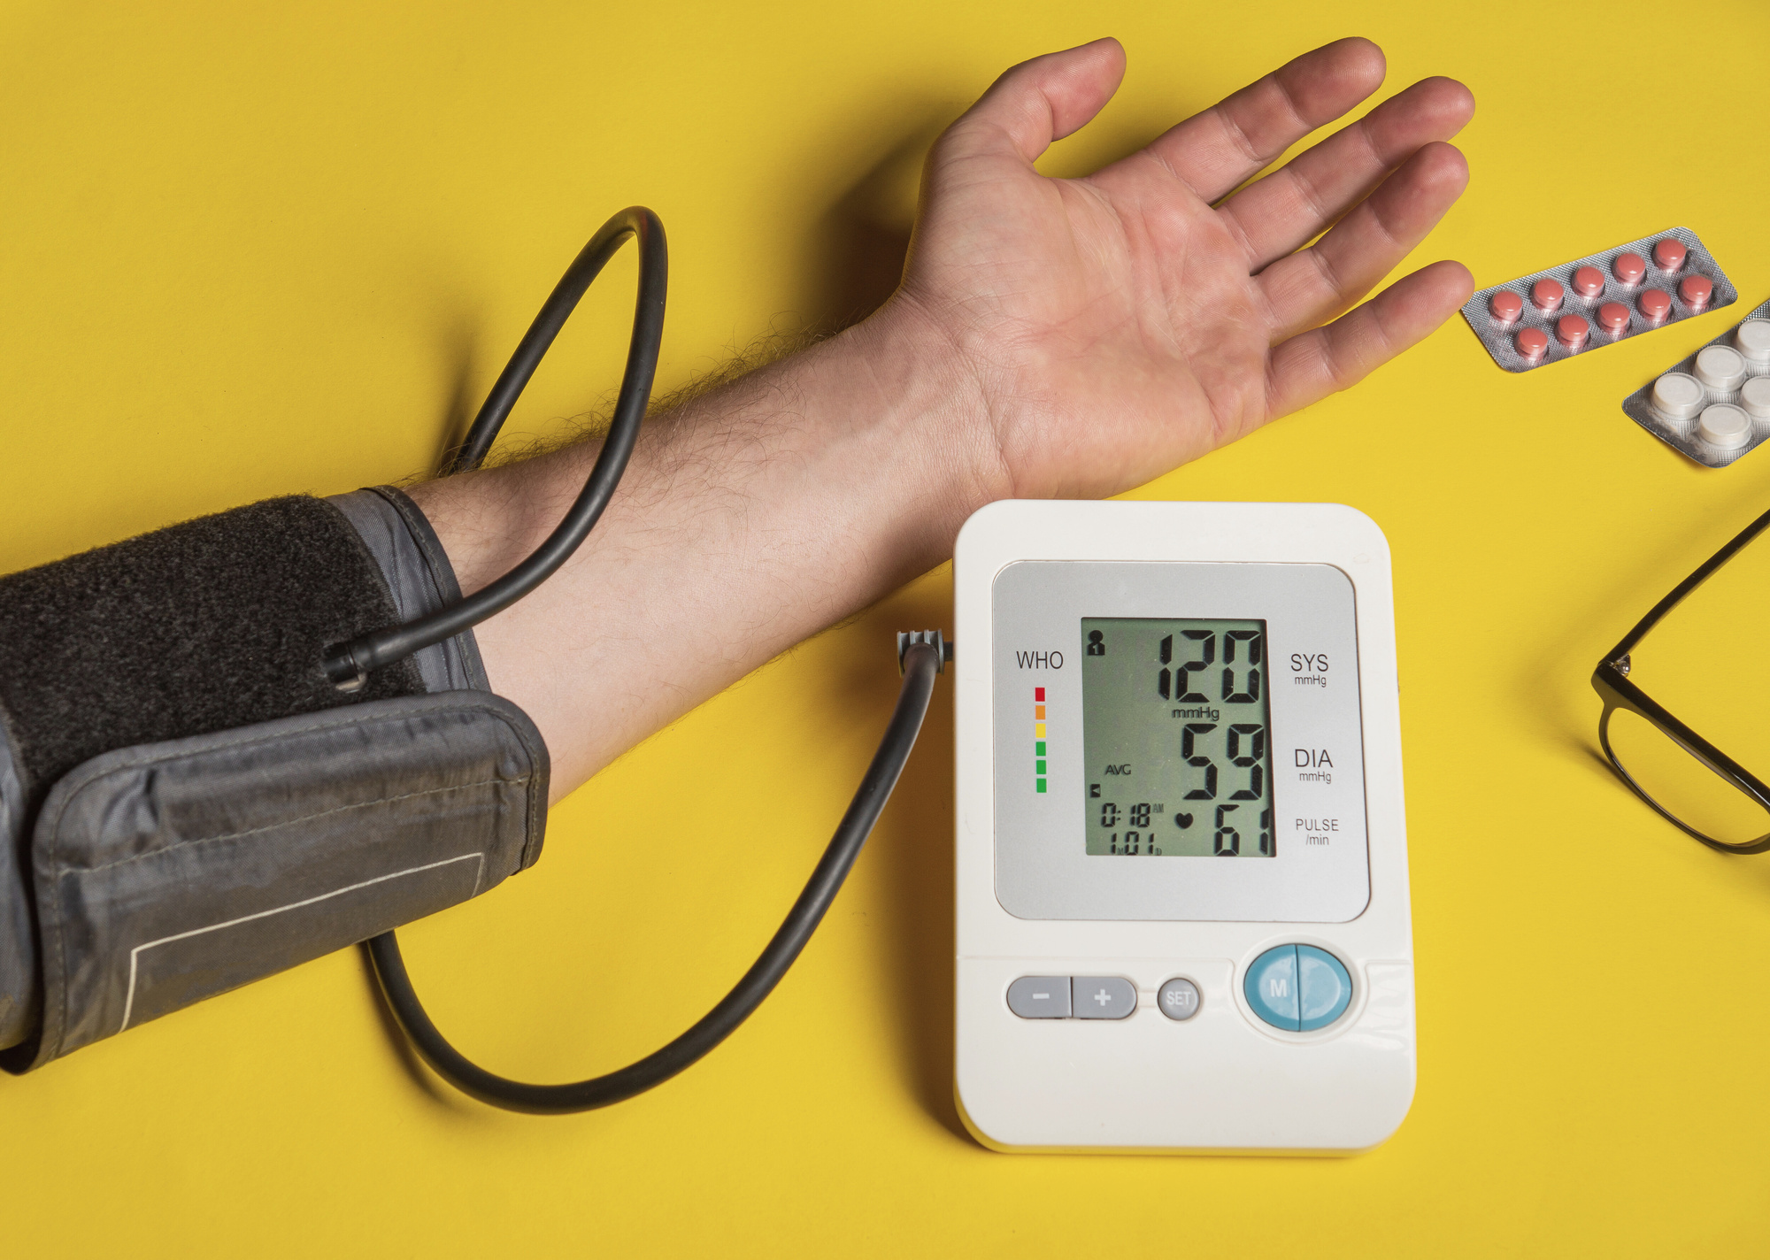
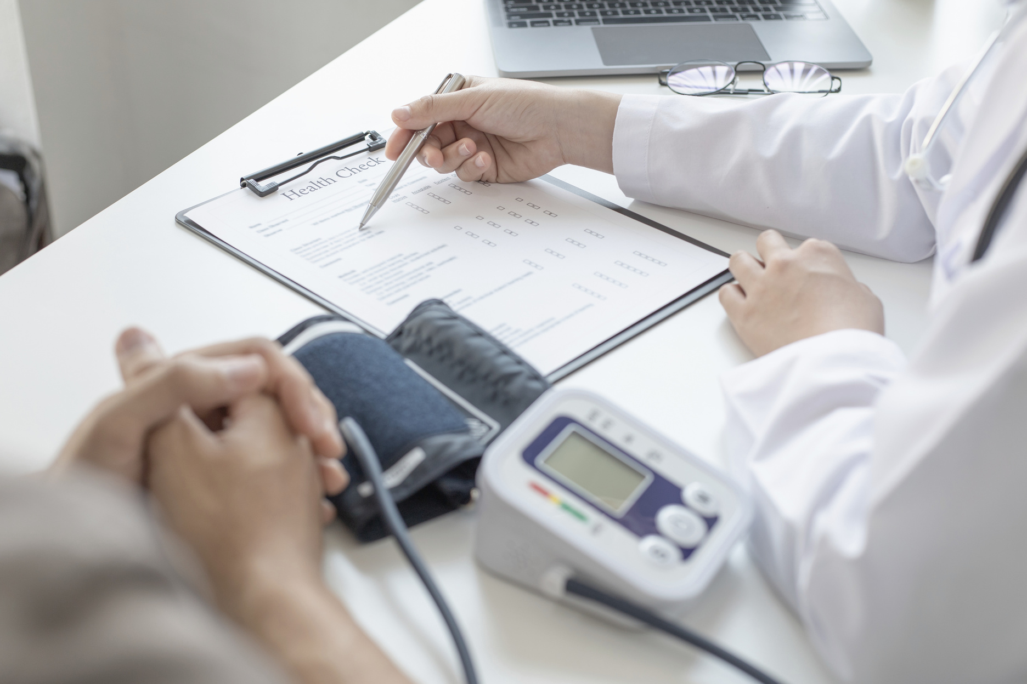

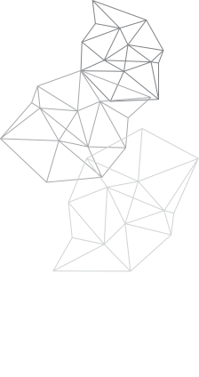
Goals and Objectives
To establish a fast, reliable, and accessible AI screening tool for immediate triage of lung conditions, significantly improving the efficiency and consistency of the radiological workflow.
Develop a model to classify 4 conditions (Covid-19, Normal, Viral, Bacterial Pneumonia) with an accuracy target of>95%.
Utilize MobileNetV2 architecture to guarantee a fast inference time (< 5 seconds per image) for immediate clinical triage.

Slide 5

Tech Stack
Python
Scikit-learn
Matplotlib
MobileNetV2
TensorFlow
Kaggle

Slide 6
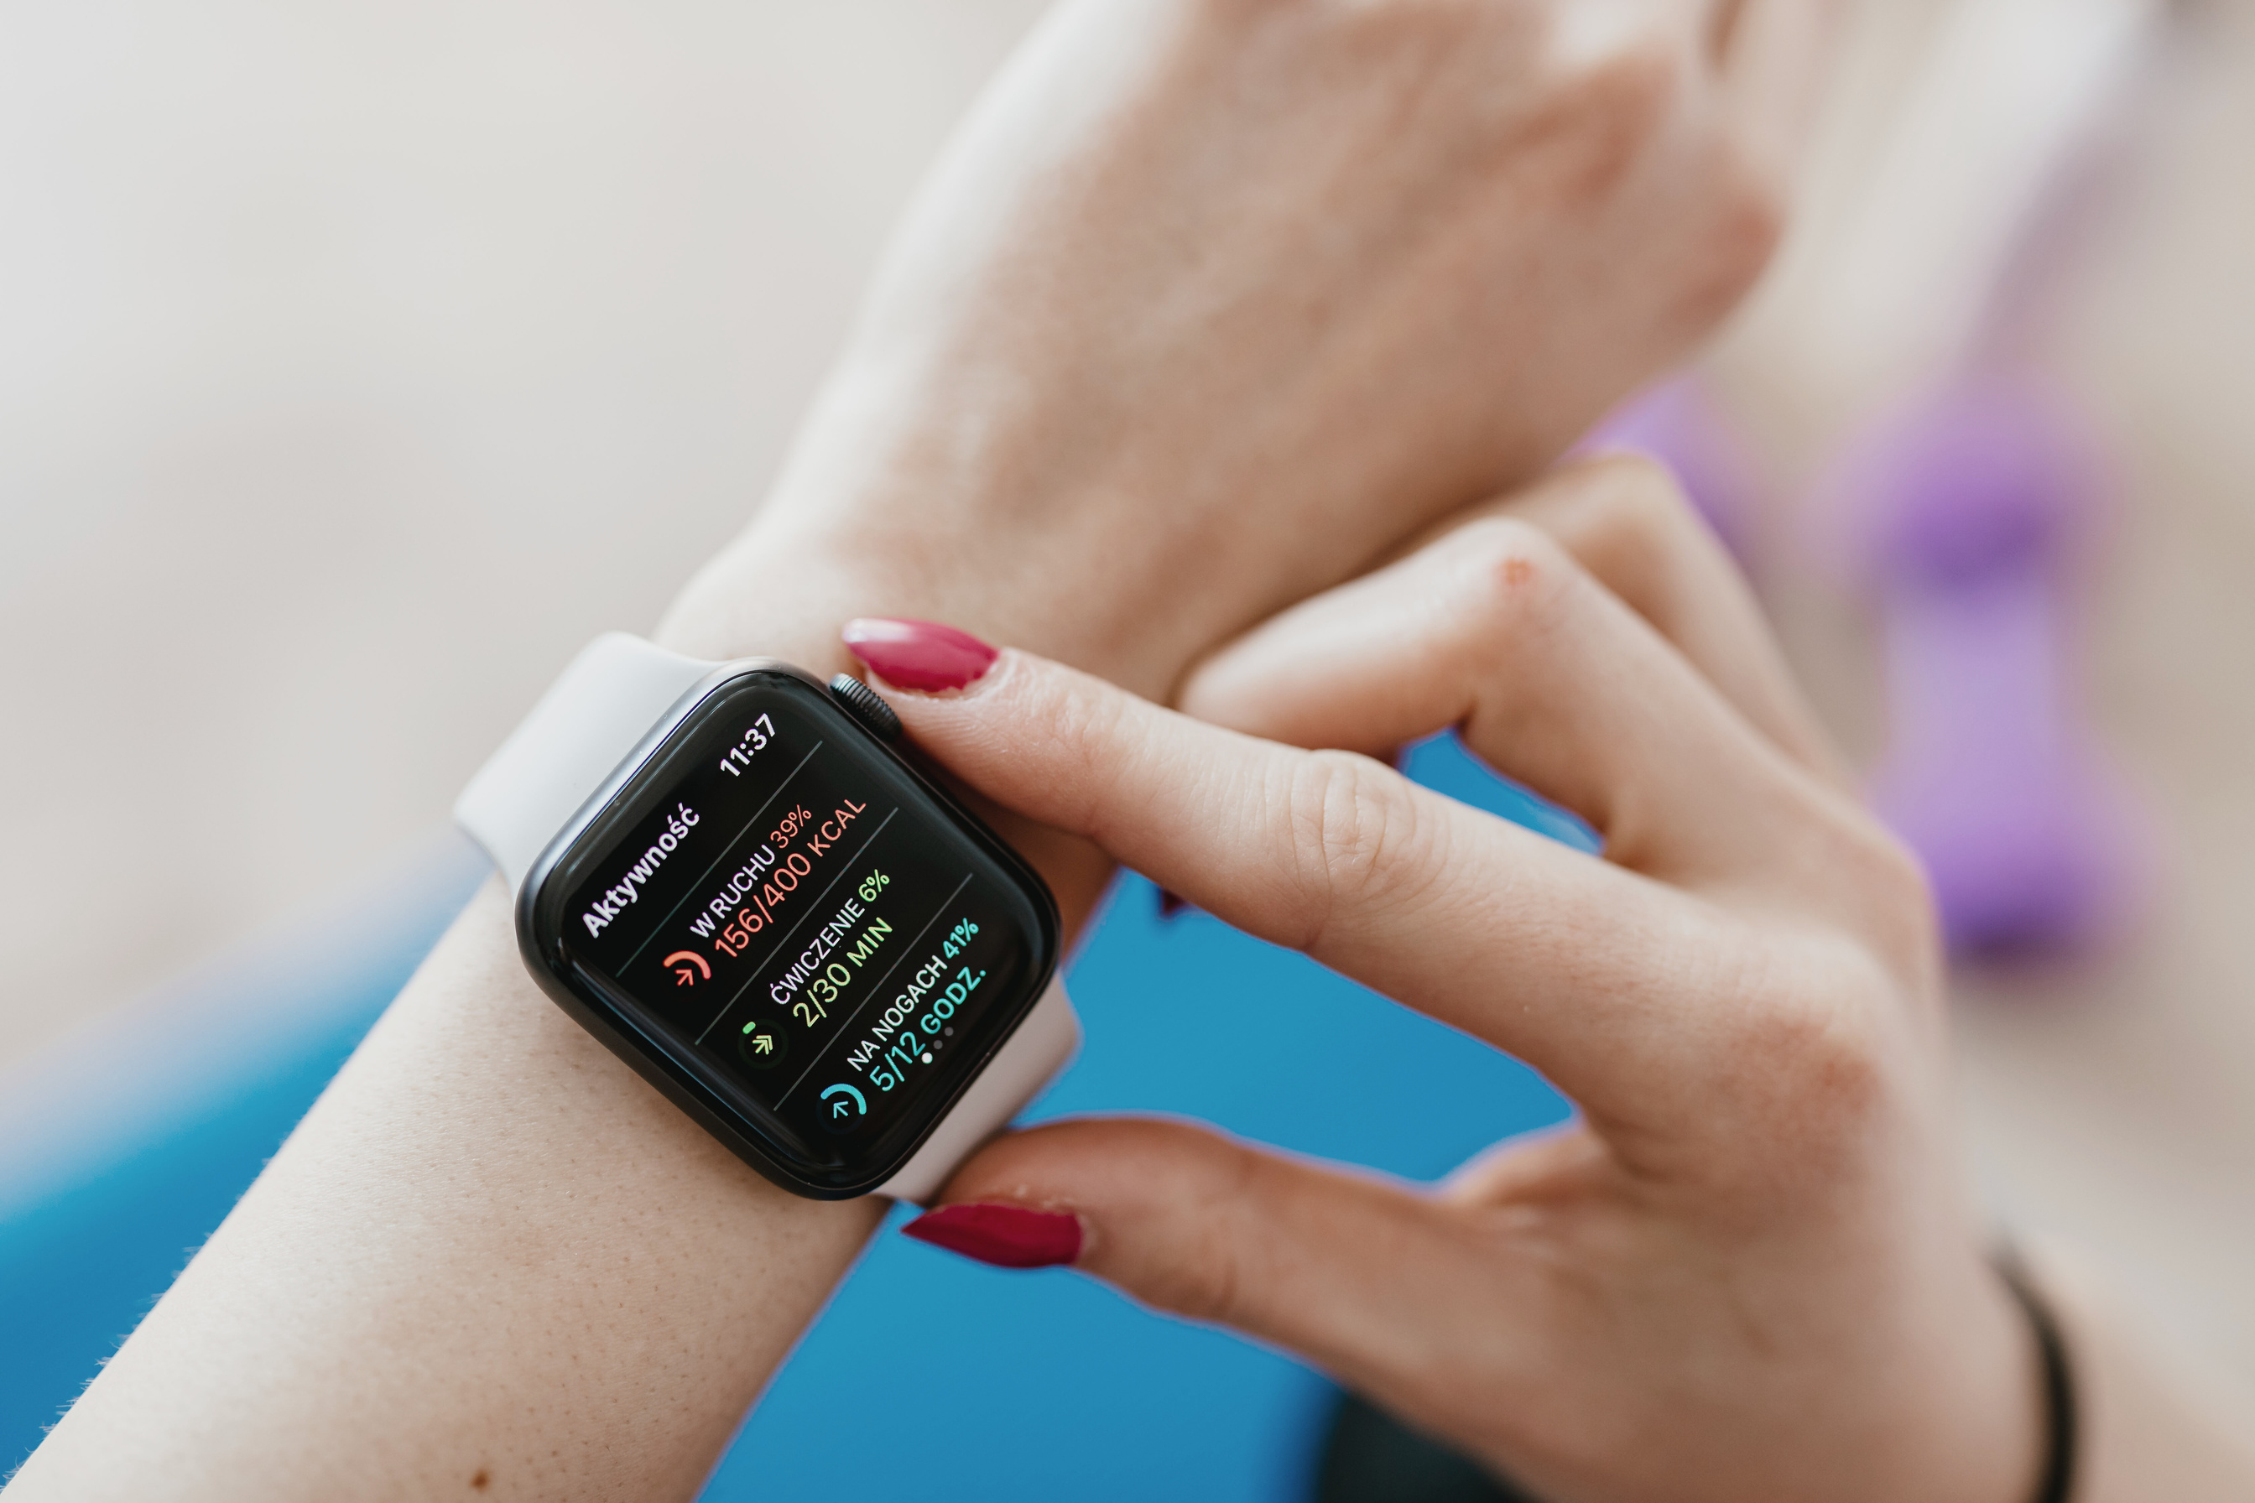
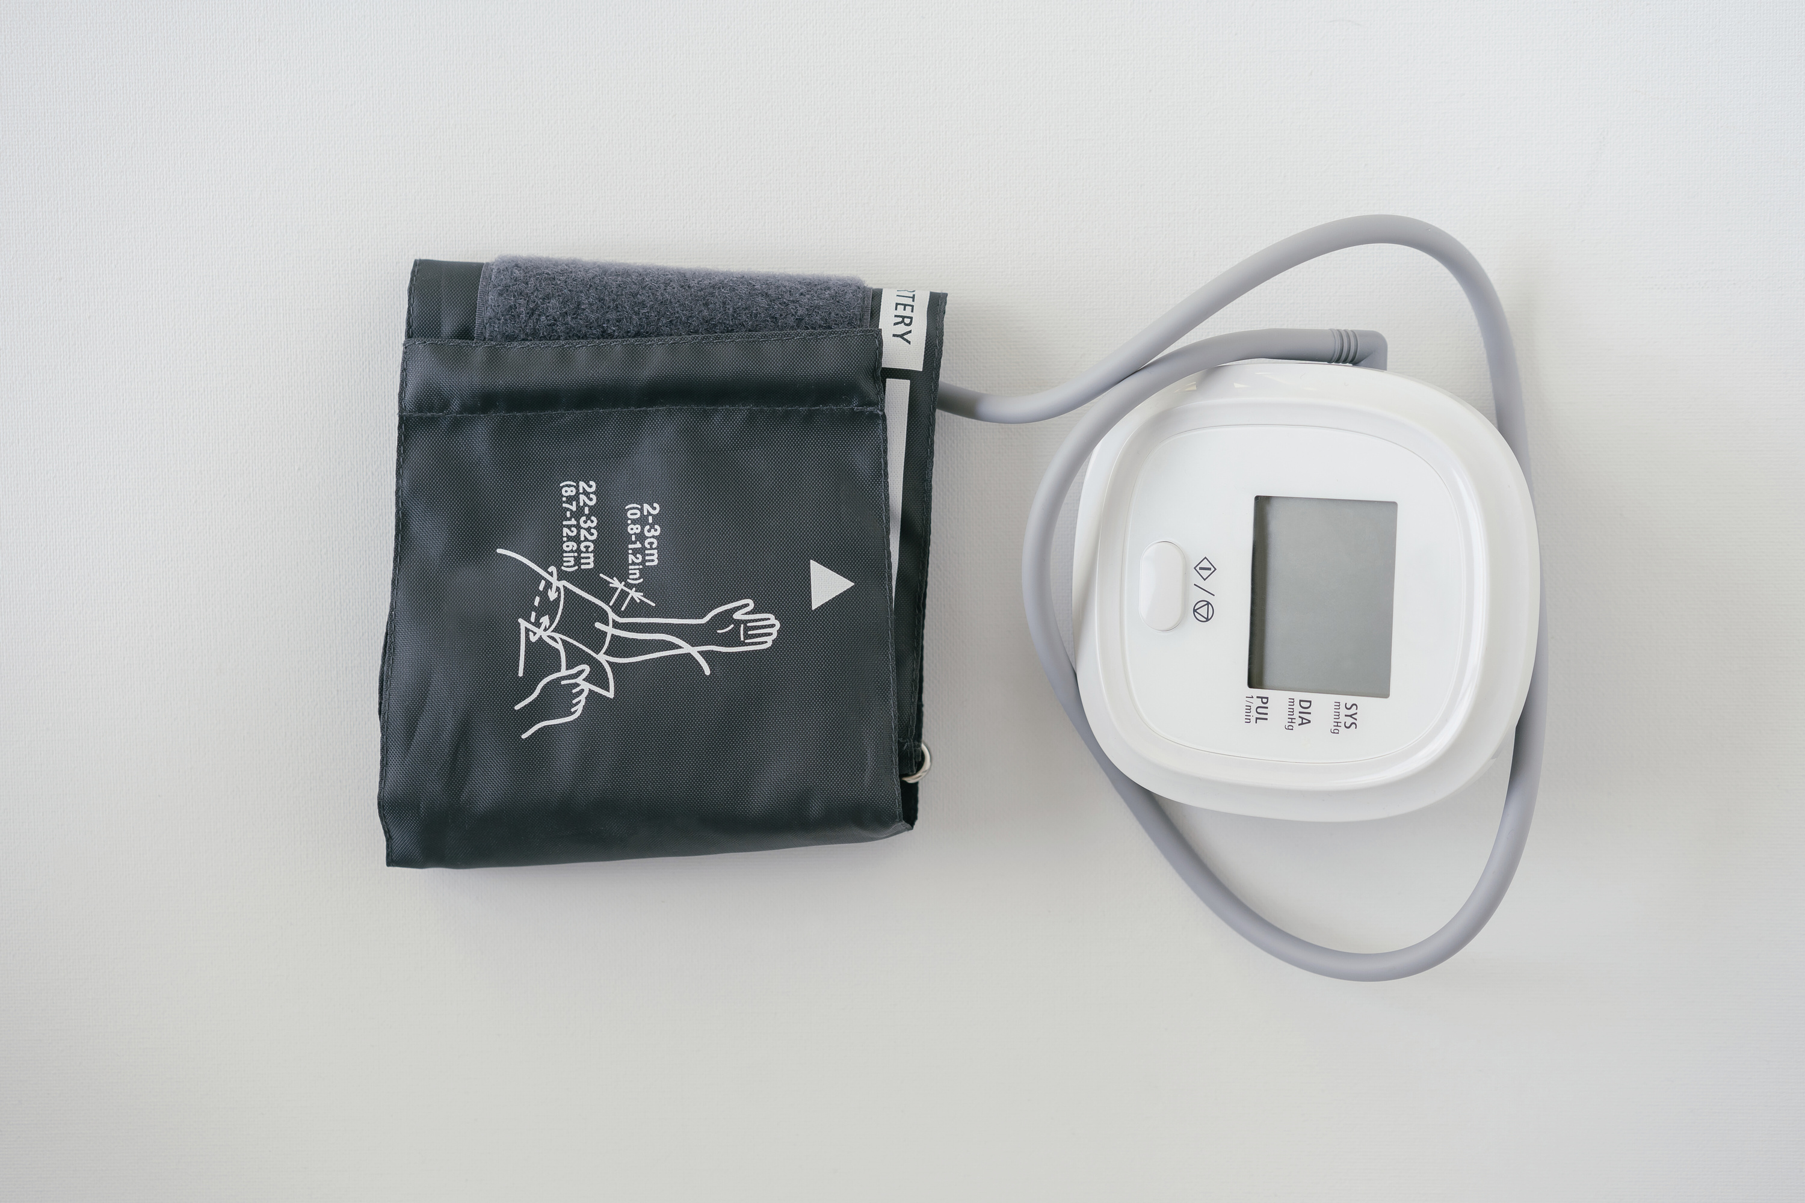
Deep Learning using MobileNetV2
High computational efficiency (lightweight model)
Multi-Class Classification (4 classes)
Regularization — Dropout + L2
Features
Transfer Learning for better performance
Data Augmentation to reduce overfitting

Slide 7


Future Prospects
Improved Accuracy: Enhance prediction by fine-tuning the model with larger and more diverse datasets.
Support More Diseases: Extend the model to detect additional lung conditions such as COPD, lung cancer, or fibrosis.
Integration with Hospitals: Connect with medical record systems (EHRs) to streamline clinical workflow.
User-Friendly UI: Develop a web or mobile interface for easy image upload and automated report generation.

Slide 8
THANK
YOU

